Slide 1


Inheritance
Fundamental Computer Programming C++
Dr. Ihsan Ullah
ihsan@saturn.yzu.edu.tw
Office: 60913

Slide 2
Introduction to Inheritance
New class inherits from existing, enhancing code reusability.
Creates new classes, reduces redundancy, and fosters modular design.
Inherits attributes and methods, enabling extension and specialization

Slide 3

Inheritance why?

Slide 4
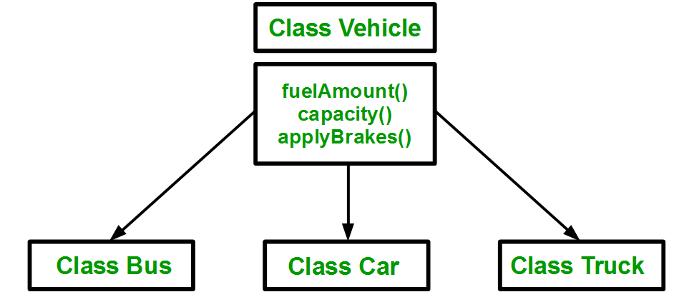
Inheritance

Slide 5
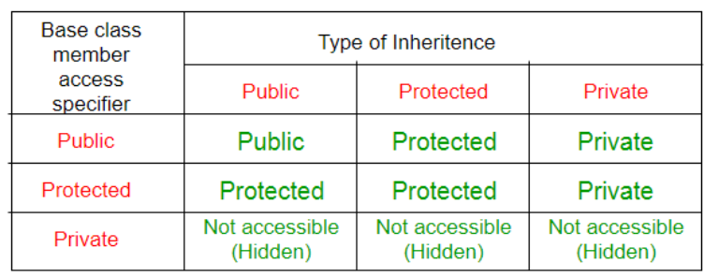
Inheritance visibility
In general, the visibility of a member in a child class depends on:
The member visibility by the parent.
The inheritance modifier.

Slide 6
Inheritance
The capability of a class to derive properties and characteristics from another class is called Inheritance
Through inheritance, we may create new classes from existing classes.
A derived (child) class inherits a base (parent) class.

Slide 7
Introduction to Inheritance
Single Inheritance: A derived class inherits from only one base class.
Multiple Inheritance: A derived class inherits from two or more base classes.
Hierarchical Inheritance: Multiple derived classes inherit from a single base class.
Multilevel Inheritance: A derived class serves as the base class for another derived class, forming a chain.
Hybrid Inheritance: A combination of multiple and hierarchical inheritance, involving more complex class structures.

Slide 8
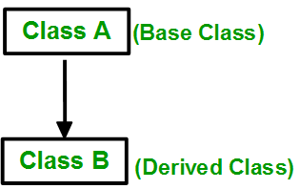
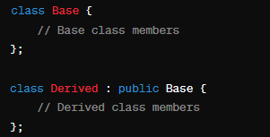
Single Inheritance
A class inherits attributes and methods from a single base class. It forms a simple parent-child relationship.

Slide 9
Single Inheritance
#include <iostream>
using namespace std;
// Base class
class Animal {
public:
void eat() {
cout << "Animal eats food." << endl;
}
};
// Derived class
class Dog : public Animal {
public:
void bark() {
cout << "Dog barks." << endl;
}
};
int main() {
Dog dog;
dog.eat(); // Inherited from Animal
dog.bark(); // Specific to Dog
return 0;
}

Slide 10
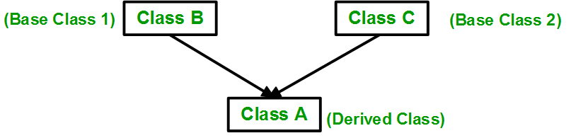
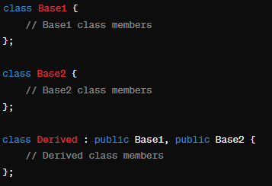
Multiple inheritance
A class can inherit from more than one class. i.e one subclass is inherited from more than one base class.
Code Example 3

Slide 11
Multiple inheritance
#include <iostream>
using namespace std;
class Animal { // Base class 1
public:
void eat() {
cout << "Animal eats food." << endl; }
};
class Pet { // Base class 2
public:
void play() {
cout << "Pet plays." << endl; }
};
class Dog : public Animal, public Pet { // Derived class
public:
void bark() {
cout << "Dog barks." << endl;
}
};
int main() {
Dog dog;
dog.eat(); // Inherited from Animal
dog.play(); // Inherited from Pet
dog.bark(); // Specific to Dog
return 0; }

Slide 12
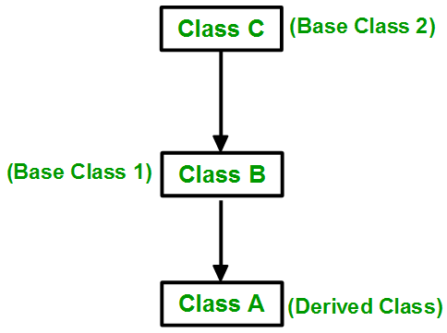
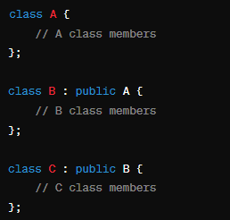
Multilevel Inheritance:
In this type of inheritance, a derived class is created from another derived class.
Code Example 4

Slide 13
Multilevel Inheritance:
#include <iostream>
using namespace std;
class Animal { // Base class
public:
void eat() {
cout << "Animal eats food." << endl;
}
};
class Dog : public Animal { // Derived class 1
public:
void bark() {
cout << "Dog barks." << endl;
}
};
class Puppy : public Dog { // Derived class 2 (inherits from Dog)
public:
void play() {
cout << "Puppy plays." << endl;
}
};
int main() {
Puppy puppy;
puppy.eat(); // Inherited from Animal
puppy.bark(); // Inherited from Dog
puppy.play(); // Specific to Puppy
return 0; }

Slide 14
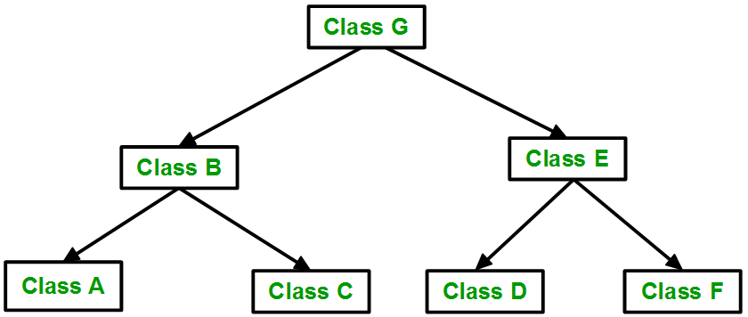
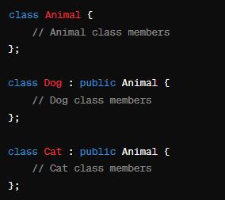
Hierarchical Inheritance:
More than one subclass is inherited from a single base class.

Slide 15
Hierarchical Inheritance:
#include <iostream>
using namespace std;
class Animal { // Base class
public:
void eat() {
cout << "Animal eats food." << endl;
}
};
class Dog : public Animal { // Derived class 1
public:
void bark() {
cout << "Dog barks." << endl;
}
};
class Cat : public Animal { // Derived class 2
public:
void meow() {
cout << "Cat meows." << endl;
}
};
int main() {
Dog dog;
Cat cat;
dog.eat(); // Inherited from Animal
dog.bark(); // Specific to Dog
cat.eat(); // Inherited from Animal
cat.meow(); // Specific to Cat
return 0;
}

Slide 16
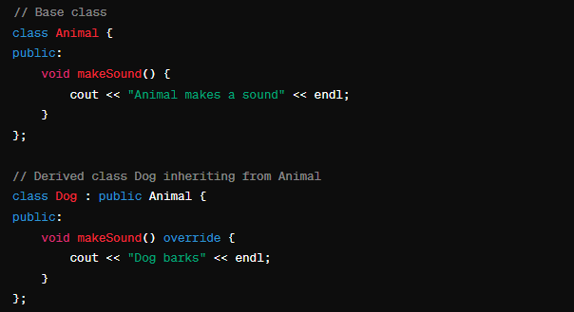
Function overriding in inheritance
Function overriding allows a derived class to define its own version of a function that has been previously defined in its base class.

Slide 17
Function overloading
It is about defining multiple functions with the same name but different signatures (parameters).
Function overriding
It is about redefining a function in a derived class to change or extend the behavior of a base class function.

Slide 18
Function Overloading
#include <iostream>
using namespace std;
class Printer {
public:
// Function to print an integer
void print(int i) {
cout << "Printing integer: " << i << endl;
}
// Function to print a double
void print(double d) {
cout << "Printing double: " << d << endl;
}
// Function to print a string
void print(string s) {
cout << "Printing string: " << s << endl;
}
};
int main() {
Printer p;
p.print(10); // Calls print(int)
p.print(3.14); // Calls print(double)
p.print("Hello"); // Calls print(string)
}

Slide 19
Function Overriding
#include <iostream>
using namespace std;
// Base class
class Animal {
public:
// Virtual function to be overridden
virtual void sound() {
cout << "Animal makes a sound." << endl;
}
};
// Derived class
class Dog : public Animal {
public:
// Override the base class function
void sound() override {
cout << "Dog barks." << endl;
}
};
int main() {
// Creating an object of type Dog
Dog dog;
// Calling the overridden function on the object
dog.sound(); // Calls Dog's sound() due to function overriding
return 0;
}

